Slide 2
The Future of Blazor on the Client
Daniel Roth
Notes:
In this session we’ll look at how Blazor in .NET Core 3.0 is a flexible and productive client UI framework for the web and beyond. We’ll look at the future of running Blazor apps client-side in the browser via WebAssembly. We’ll discuss the benefits of hosting Blazor WebAssembly apps with .NET Core to enable full-stack web development with .NET and C#. We’ll also look at taking Blazor beyond the web to support desktop and mobile app development.

Slide 3






So many platforms, so little time…
?

Slide 4
Web
Blazor Server
Web app
Every interaction handled on server
Prerendered HTML (optional)
Blazor WebAssembly
Web app with client-side execution
Loaded from web server
Can work offline via Service Worker
Desktop
+ Mobile

Slide 5
Blazor WebAssembly

Slide 6
Web
Blazor Server
Web app
Every interaction handled on server
Prerendered HTML (optional)
Blazor WebAssembly
Web app with client-side execution
Loaded from web server
Can work offline via Service Worker
Blazor PWA – OS installed
Appears as native app (own window)
Works offline or online
Desktop
+ Mobile

Slide 7
What is a PWA?
Progress Web App (PWA): A web app that users modern web standards to provide a closer-to-native user experience.
Works offline
Push notifications
Fast & responsive
OS installable

Slide 8
Blazor PWA

Slide 9
Web
Blazor Server
Web app
Every interaction handled on server
Prerendered HTML (optional)
Blazor WebAssembly
Web app with client-side execution
Loaded from web server
Can work offline via Service Worker
Blazor PWA – OS installed
Appears as native app (own window)
Works offline or online
Blazor Hybrid
Native .NET renders to Electron / WebView
Appears as native app (own window)
Works offline or online
Desktop
+ Mobile

Slide 10
Blazor Hybrid

Slide 11
Web
Blazor Server
Web app
Every interaction handled on server
Prerendered HTML (optional)
Blazor WebAssembly
Web app with client-side execution
Loaded from web server
Can work offline via Service Worker
Blazor PWA – OS installed
Appears as native app (own window)
Works offline or online
Blazor Hybrid
Native .NET renders to Electron / WebView
Appears as native app (own window)
Works offline or online
Desktop
+ Mobile
Blazor Native
Same programming model, but
rendering non-HTML UI

Slide 12
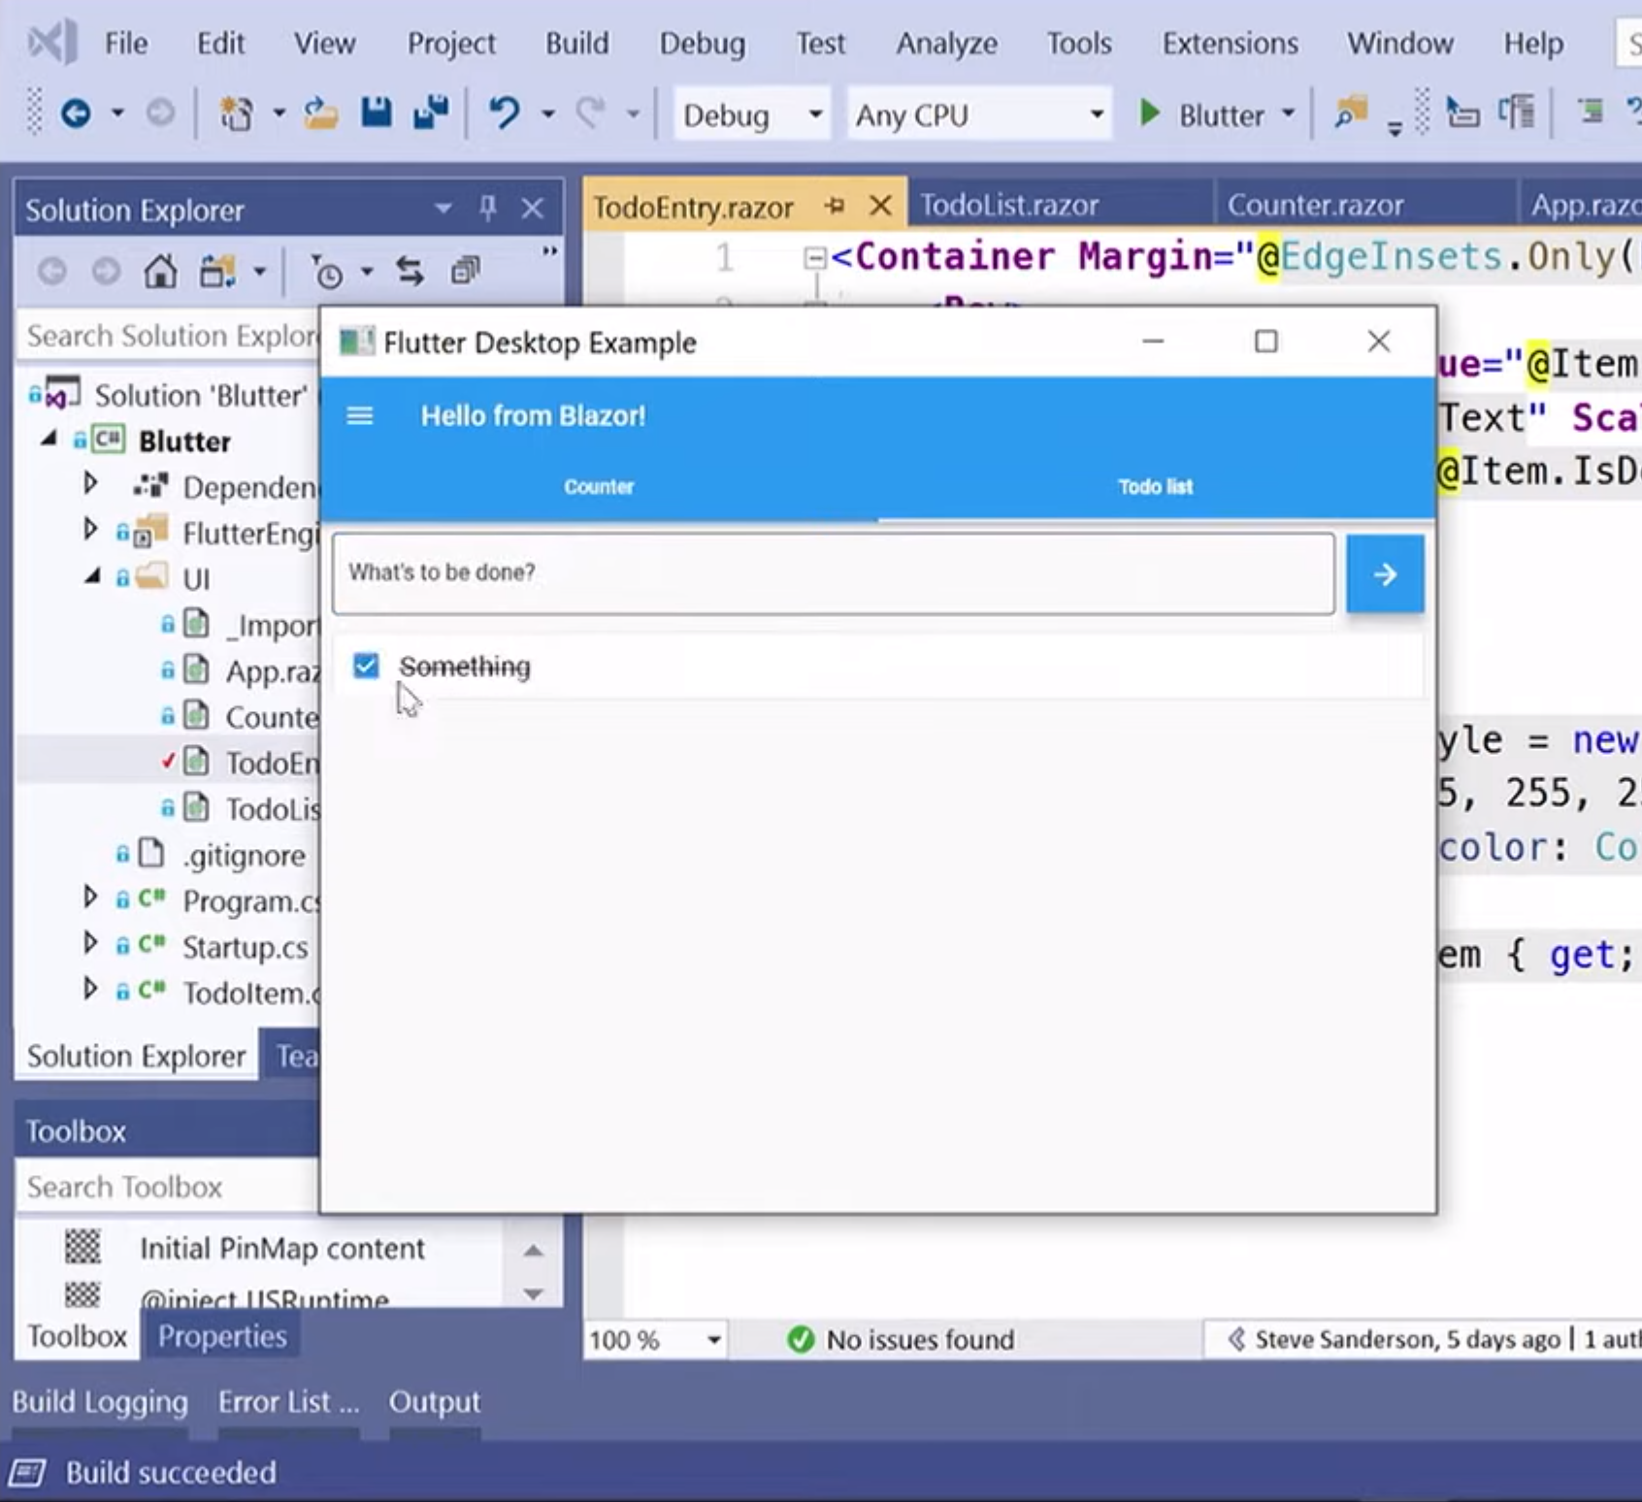
Blazor Native
By default, Blazor renders to HTML
But the rendering layer is replaceable
Possible to render to native controls instead
Currently exploring different options
https://aka.ms/blutter

Slide 13
Blazor roadmap
Blazor Server – Shipped with .NET Core 3.0!
Blazor WebAssembly – May 2020
Blazor PWA & Electron – Previews with .NET 5
Blazor Native – Under investigation

Slide 14
Try Blazor today!
Blazor: https://blazor.net
Docs: https://blazor.net/docs
.NET Core 3.0: https://dot.net/get-core3
Visual Studio: https://visualstudio.com/
Workshop: https://aka.ms/blazorworkshop
Community: https://aka.ms/awesomeblazor

